Slide 1
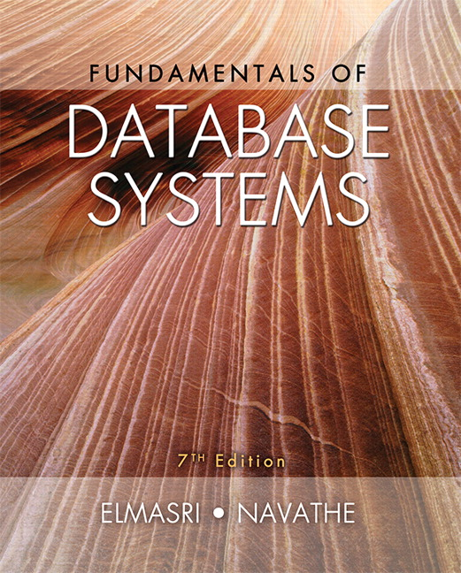

Slide 2
CHAPTER 17
Indexing Structures for Files and Physical Database Design

Slide 3
Introduction
Indexes used to speed up record retrieval in response to certain search conditions
Index structures provide secondary access paths
Any field can be used to create an index
Multiple indexes can be constructed
Most indexes based on ordered files
Tree data structures organize the index

Slide 4
17.1 Types of Single-Level Ordered Indexes
Ordered index similar to index in a textbook
Indexing field (attribute)
Index stores each value of the index field with list of pointers to all disk blocks that contain records with that field value
Values in index are ordered
Primary index
Specified on the ordering key field of ordered file of records

Slide 5
Types of Single-Level Ordered Indexes (cont’d.)
Clustering index
Used if numerous records can have the same value for the ordering field
Secondary index
Can be specified on any nonordering field
Data file can have several secondary indexes

Slide 6
Primary Indexes
Ordered file with two fields
Primary key, K(i)
Pointer to a disk block, P(i)
One index entry in the index file for each block in the data file
Indexes may be dense or sparse
Dense index has an index entry for every search key value in the data file
Sparse index has entries for only some search values

Slide 7
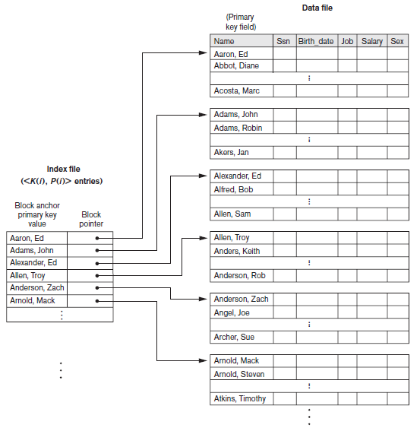
Primary Indexes (cont’d.)
Figure 17.1 Primary index on the ordering key field of the file shown in Figure 16.7

Slide 8
Primary Indexes (cont’d.)
Major problem: insertion and deletion of records
Move records around and change index values
Solutions
Use unordered overflow file
Use linked list of overflow records

Slide 9
Clustering Indexes
Clustering field
File records are physically ordered on a nonkey field without a distinct value for each record
Ordered file with two fields
Same type as clustering field
Disk block pointer

Slide 10
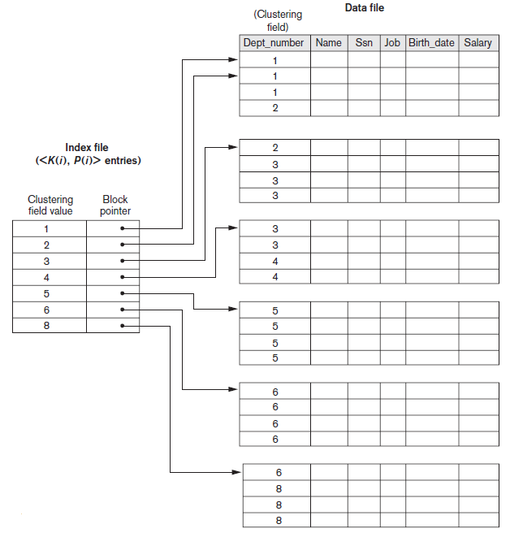
Clustering Indexes (cont’d.)
Figure 17.2 A clustering index on the Dept_number ordering nonkey field of an EMPLOYEE file

Slide 11
Secondary Indexes
Provide secondary means of accessing a data file
Some primary access exists
Ordered file with two fields
Indexing field, K(i)
Block pointer or record pointer, P(i)
Usually need more storage space and longer search time than primary index
Improved search time for arbitrary record

Slide 12
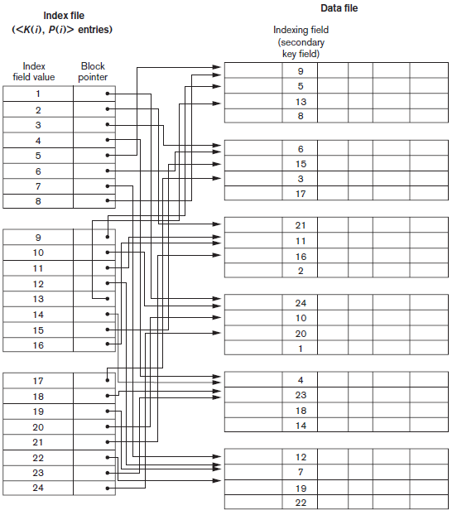
Secondary Indexes (cont’d.)
Figure 17.4 Dense secondary index (with block pointers) on a nonordering key field of a file.

Slide 13
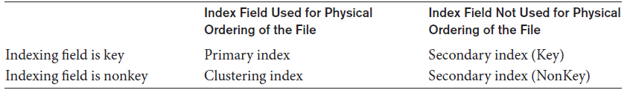
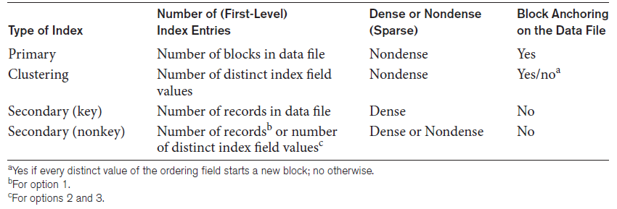
Types of Single-Level Ordered Indexes (cont’d.)
Table 17.1 Types of indexes based on the properties of the indexing field
Table 17.2 Properties of index types

Slide 14
17.2 Multilevel Indexes
Designed to greatly reduce remaining search space as search is conducted
Index file
Considered first (or base level) of a multilevel index
Second level
Primary index to the first level
Third level
Primary index to the second level

Slide 15
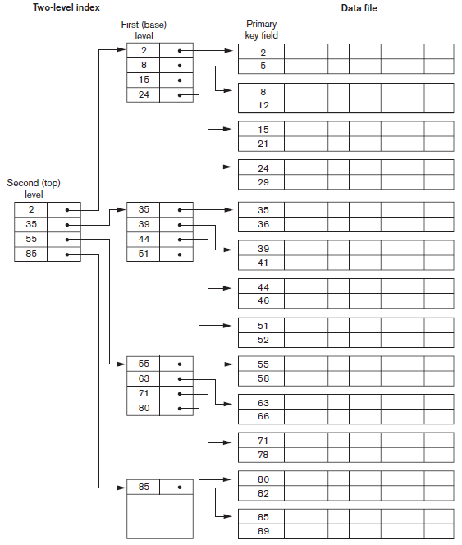
Figure 17.6 A two-level primary index resembling ISAM (indexed sequential access method) organization

Slide 16
17.3 Dynamic Multilevel Indexes Using B-Trees and B+ -Trees
Tree data structure terminology
Tree is formed of nodes
Each node (except root) has one parent and zero or more child nodes
Leaf node has no child nodes
Unbalanced if leaf nodes occur at different levels
Nonleaf node called internal node
Subtree of node consists of node and all descendant nodes

Slide 17
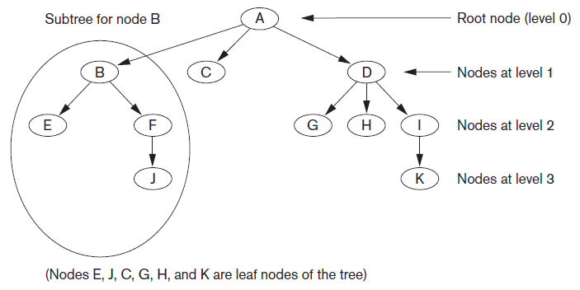
Tree Data Structure
Figure 17.7 A tree data structure that shows an unbalanced tree

Slide 18
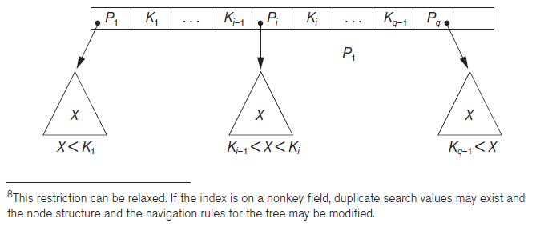
Search Trees and B-Trees
Search tree used to guide search for a record
Given value of one of record’s fields
Figure 17.8 A node in a search tree with pointers to subtrees below it

Slide 19
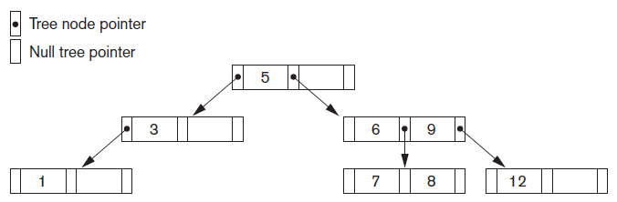
Search Trees and B-Trees (cont’d.)
Algorithms necessary for inserting and deleting search values into and from the tree
Figure 17.9 A search tree of order p = 3

Slide 20
B-Trees
Provide multi-level access structure
Tree is always balanced
Space wasted by deletion never becomes excessive
Each node is at least half-full
Each node in a B-tree of order p can have at most p-1 search values

Slide 21
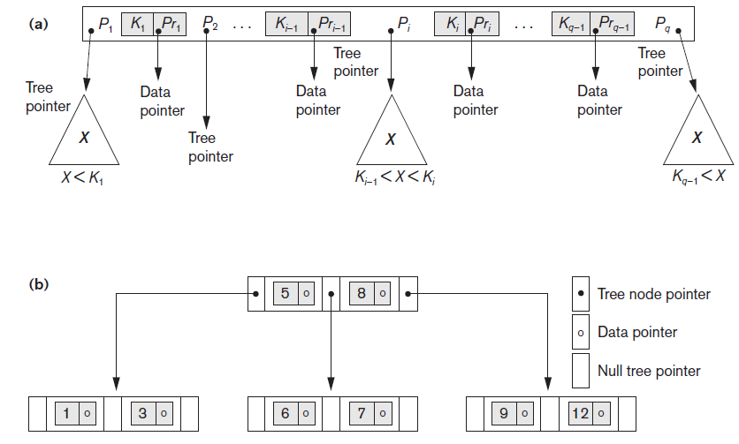
B-Tree Structures
Figure 17.10 B-tree structures (a) A node in a B-tree with q−1 search values (b) A B-tree of order p=3. The values were inserted in the order 8, 5, 1, 7, 3, 12, 9, 6

Slide 22
B+ -Trees
Data pointers stored only at the leaf nodes
Leaf nodes have an entry for every value of the search field, and a data pointer to the record if search field is a key field
For a nonkey search field, the pointer points to a block containing pointers to the data file records
Internal nodes
Some search field values from the leaf nodes repeated to guide search

Slide 23
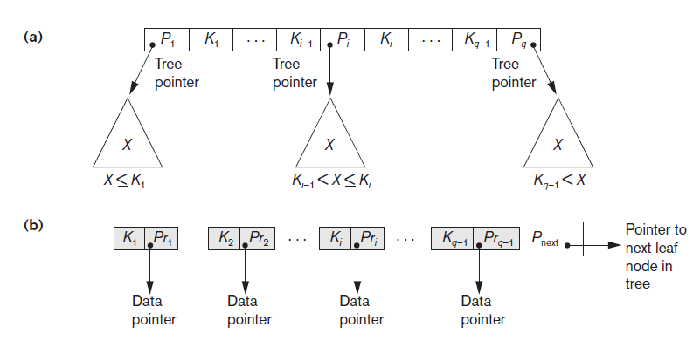
B+ -Trees (cont’d.)
Figure 17.11 The nodes of a B+-tree (a) Internal node of a B+-tree with q−1 search values (b) Leaf node of a B+-tree with q−1 search values and q−1 data pointers

Slide 24
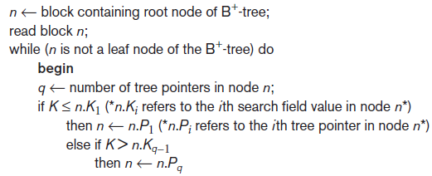
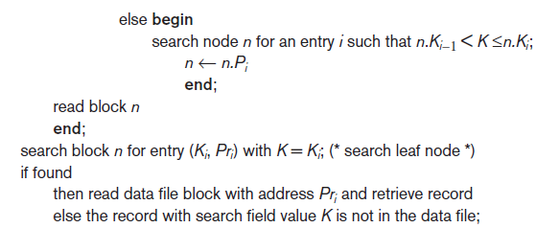
Searching for a Record With Search Key Field Value K, Using a B+ -Tree
Algorithm 17.2 Searching for a record with search key field value K, using a B+ -Tree

Slide 25
17.4 Indexes on Multiple Keys
Multiple attributes involved in many retrieval and update requests
Composite keys
Access structure using key value that combines attributes eg: (Dno, Age)
Lexicographic ordering on tuples
<3,n>……. <4,m>
Eg :<2,40> <2,45>,<3,5>

Slide 26
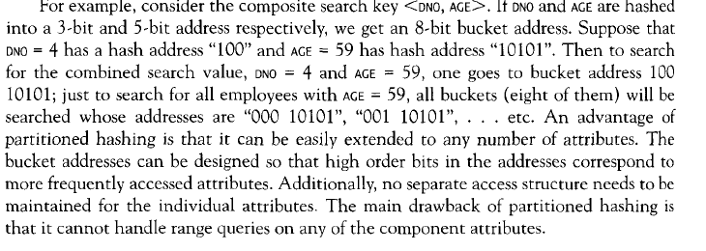
Partitioned hashing
Suitable for equality comparisons

Slide 27
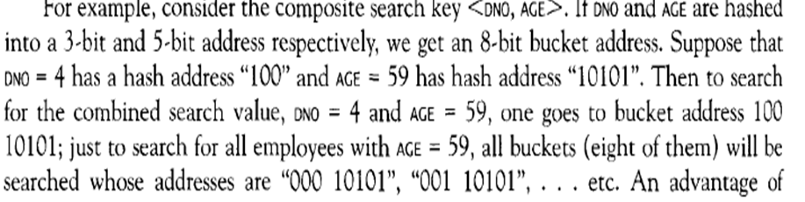

Slide 28
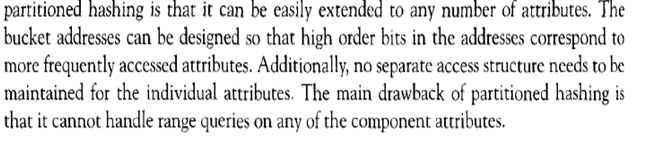

Slide 29
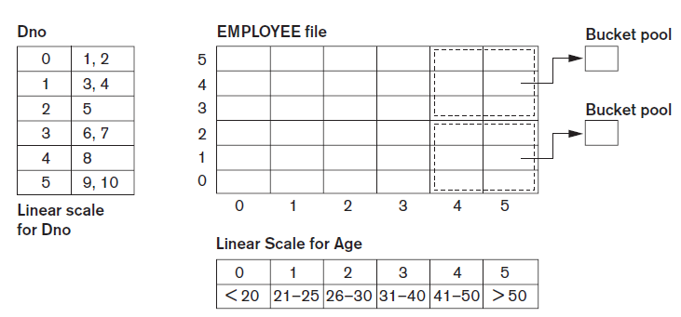
Indexes on Multiple Keys (cont’d.)
Grid files
Array with one dimension for each search attribute
Figure 17.14 Example of a grid array on Dno and Age attributes
Buckets having pointers to employess of age >=41 in deprtment 1-5 and 6 to 7

Slide 30
17.5 Other Types of Indexes
Hash indexes
Secondary structure for file access
Uses hashing on a search key other than the one used for the primary data file organization
Index entries of form (K, P_{r}) or (K, P)
P_{r}: pointer to the record containing the key
P: pointer to the block containing the record for that key

Slide 31
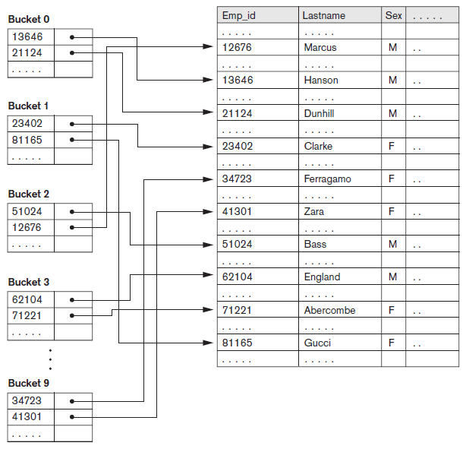
Hash Indexes (cont’d.)
Figure 17.15 Hash-based indexing

Slide 32
Bitmap Indexes
Used with a large number of rows
Creates an index for one or more columns
Each value or value range in the column is indexed
Built on one particular value of a particular field
Array of bits
Existence bitmap
Bitmaps for B+ -tree leaf nodes

Slide 33
Bitmap Indexes

Slide 34
Bitmap Indices
Bitmap indices are a special type of index designed for efficient querying on multiple keys
Very effective on attributes that take on a relatively small number of distinct values
E.g. gender, country, state, …
E.g. income-level (income broken up into a small number of levels such as 0-9999, 10000-19999, 20000-50000, 50000- infinity)
A bitmap is simply an array of bits
For each gender, we associate a bitmap, where each bit represents whether or not the corresponding record has that gender.

Slide 35
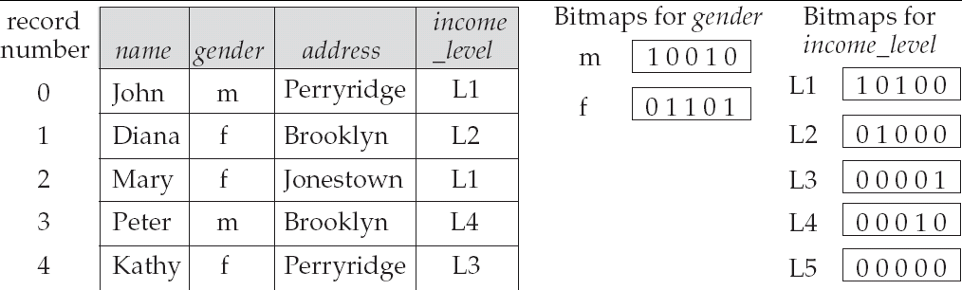
Bitmap Indices (Cont.)
In its simplest form a bitmap index on an attribute has a bitmap for each value of the attribute
Bitmap has as many bits as records
In a bitmap for value v, the bit for a record is 1 if the record has the value v for the attribute, and is 0 otherwise

Slide 36
Bitmap Indices (Cont.)
Bitmap indices are useful for queries on multiple attributes
not particularly useful for single attribute queries
Queries are answered using bitmap operations
Intersection (and)
Union (or)
Complementation (not)
Each operation takes two bitmaps of the same size and applies the operation on corresponding bits to get the result bitmap
E.g. 100110 AND 110011 = 100010
100110 OR 110011 = 110111 NOT 100110 = 011001
Males with income level L1:
And’ing of Males bitmap with Income Level L1 bitmap
10010 AND 10100 = 10000
Can then retrieve required tuples.
Counting number of matching tuples is even faster

Slide 37
Bitmap Indices (Cont.)
Bitmap indices generally very small compared with relation size
E.g. if record is 100 bytes, space for a single bitmap is 1/800 of space used by relation.
If number of distinct attribute values is 8, bitmap is only 1% of relation size
Deletion needs to be handled properly
Existence bitmap to note if there is a valid record at a record location
Needed for complementation
not(A=v): (NOT bitmap-A-v) AND ExistenceBitmap
Should keep bitmaps for all values, even null value
To correctly handle SQL null semantics for NOT(A=v):
intersect above result with (NOT bitmap-A-Null)

Slide 38
Index Definition in SQL
Create a B-tree index (default in most databases)
create index <index-name> on <relation-name> (<attribute-list>)
-- create index b-index on branch(branch_name)
-- create index ba-index on branch(branch_name, account) -- concatenated index
-- create index fa-index on branch(func(balance, amount)) – function index
Use create unique index to indirectly specify and enforce the condition that the search key is a candidate key.
Hash indexes: not supported by every database (but implicitly in joins,…)
PostgresSQL has it but discourages due to performance
Create a bitmap index
create bitmap index <index-name> on <relation-name> (<attribute-list>)
For attributes with few distinct values
Mainly for decision-support(query) and not OLTP (do not support updates efficiently)
To drop any index
drop index <index-name>

Slide 39

Function-Based Indexing
Value resulting from applying some function on a field (or fields) becomes the index key
Introduced in Oracle relational DBMS
Example
Function UPPER(Lname) returns uppercase representation
Query

Slide 40
17.6 Some General Issues Concerning Indexing
Physical index
Pointer specifies physical record address
Disadvantage: pointer must be changed if record is moved
Logical index
Used when physical record addresses expected to change frequently
Entries of the form (K, K_{p})

Slide 41

Index Creation
General form of the command to create an index
Unique and cluster keywords optional
Order can be ASC or DESC
Secondary indexes can be created for any primary record organization
Complements other primary access methods

Slide 42
Indexing of Strings
Strings can be variable length
Strings may be too long, limiting the fan-out
Prefix compression
Stores only the prefix of the search key adequate to distinguish the keys that are being separated and directed to the subtree

Slide 43
Tuning Indexes
Tuning goals
Dynamically evaluate requirements
Reorganize indexes to yield best performance
Reasons for revising initial index choice
Certain queries may take too long to run due to lack of an index
Certain indexes may not get utilized
Certain indexes may undergo too much updating if based on an attribute that undergoes frequent changes

Slide 44
Additional Issues Related to Storage of Relations and Indexes
Enforcing a key constraint on an attribute
Reject insertion if new record has same key attribute as existing record
Duplicates occur if index is created on a nonkey field
Fully inverted file
Has secondary index on every field
Indexing hints in queries
Suggestions used to expedite query execution

Slide 45
Additional Issues Related to Storage of Relations and Indexes (cont’d.)
Column-based storage of relations
Alternative to traditional way of storing relations by row
Offers advantages for read-only queries
Offers additional freedom in index creation

Slide 46
17.7 Physical Database Design in Relational Databases
Physical design goals
Create appropriate structure for data in storage
Guarantee good performance
Must know job mix for particular set of database system applications
Analyzing the database queries and transactions
Information about each retrieval query
Information about each update transaction

Slide 47
Physical Database Design in Relational Databases (cont’d.)
Analyzing the expected frequency of invocation of queries and transactions
Expected frequency of using each attribute as a selection or join attribute
80-20 rule: 80 percent of processing accounted for by only 20 percent of queries and transactions
Analyzing the time constraints of queries and transactions
Selection attributes associated with time constraints are candidates for primary access structures

Slide 48
Physical Database Design in Relational Databases (cont’d.)
Analyzing the expected frequency of update operations
Minimize number of access paths for a frequently-updated file
Updating the access paths themselves slows down update operations
Analyzing the uniqueness constraints on attributes
Access paths should be specified on all candidate key attributes that are either the primary key of a file or unique attributes

Slide 49
Physical Database Design Decisions
Design decisions about indexing
Whether to index an attribute
Attribute is a key or used by a query
What attribute(s) to index on
Single or multiple
Whether to set up a clustered index
One per table
Whether to use a hash index over a tree index
Hash indexes do not support range queries
Whether to use dynamic hashing
Appropriate for very volatile files

Slide 50
17.8 Summary
Indexes are access structures that improve efficiency of record retrieval from a data file
Ordered single-level index types
Primary, clustering, and secondary
Multilevel indexes can be implemented as B-trees and B+ -trees
Dynamic structures
Multiple key access methods
Logical and physical indexes

